Slide 1






CALYXIS MAVIE Observatory : Analyzing Accidents of Everyday Life
A dynamic tool for analyzing and visualizing accidents of everyday life (AcEL) in France
BABIN Paul / DIOUF Mariama / GASSE Armand-Valentin / BENOIT Nathaël
Calyxis Marion Dupuy, Mme Belim, M. Bureau et M. Garnier

Slide 2



Contents
Presentation of the context and requirements ----------------------------- 2
Organisation and planning of the work ---------------------------------------------- 5
Proposed approach and demonstration of tasks already completed ------------------------------------------------------------------------------------------------------------------------ 6
1

Slide 3
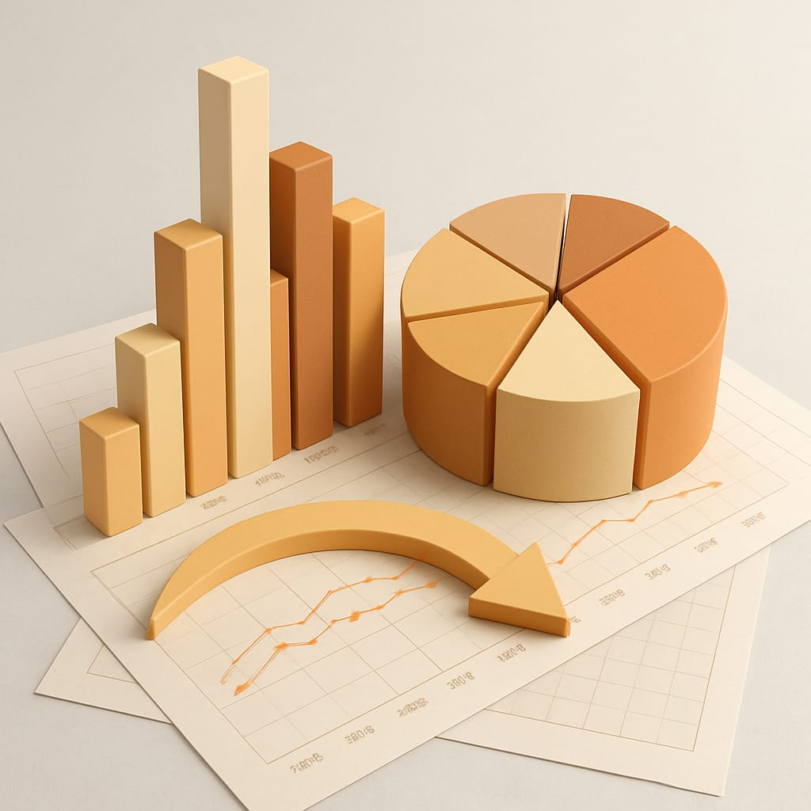
Presentation of the context and requirements
Organisation and planning of the word
Proposed approach and demonstration of tasks already completed
Objective of this project
Prevention strategies by identifying:
The most at-risk profiles
The circumstances under which accidents occur
The factors that increase or reduce the likelihood and severity of accidents
2

Slide 4





Presentation of the context and requirements
Organisation and planning of the word
Proposed approach and demonstration of tasks already completed
Project Overview
Public Health Issue
AcEL include falls, burns, poisonings at home or during leisure
MAVIE Dataset
Volunteer profiles, accident details, household information
Target Users
Health professionals, researchers, prevention organisations
3

Slide 5



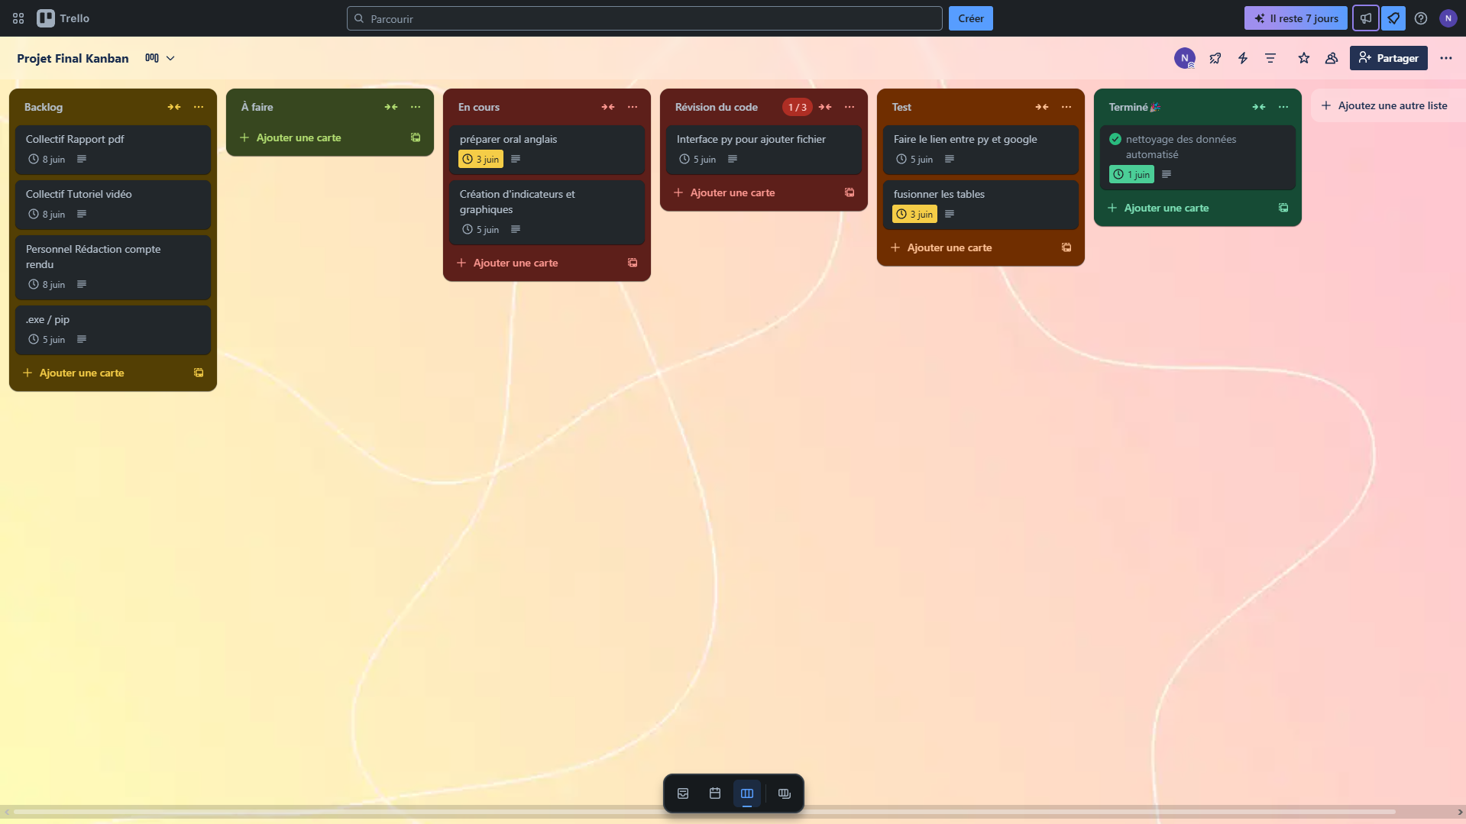


Presentation of the context and requirements
Organisation and planning of the word
Proposed approach and demonstration of tasks already completed
Project Organisation
Team Structure
Four developers with
specialised roles
Agile Methodology
Scrum with daily meetings
Project Management
Trello for task tracking, deadlines
and userstory
Internal Deadlines
Specific targets for efficient progress
4

Slide 6
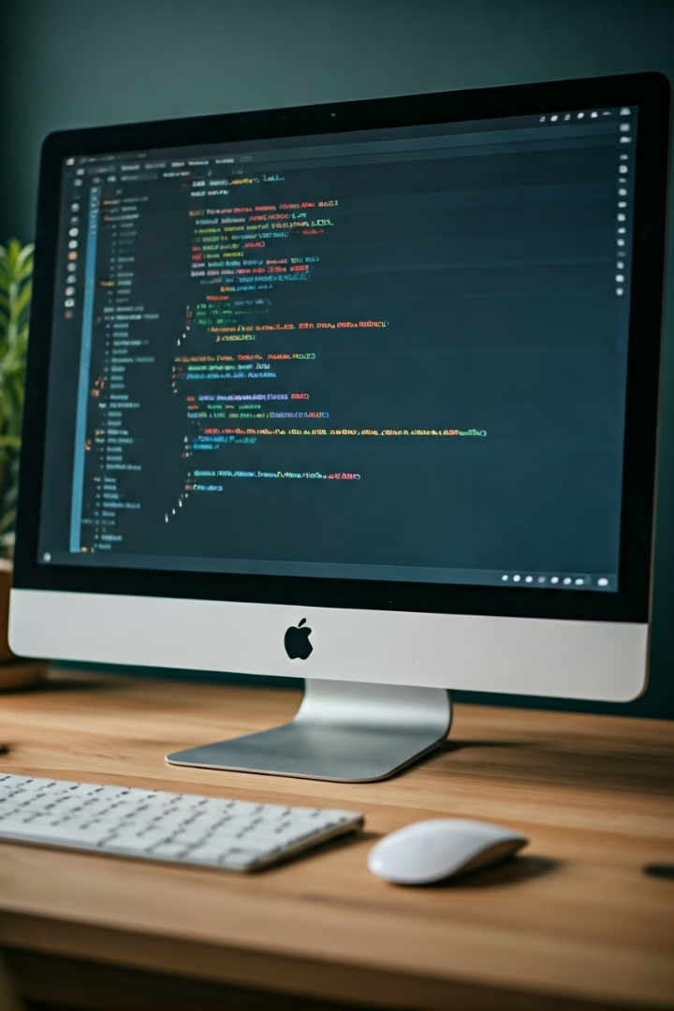




Presentation of the context and requirements
Organisation and planning of the word
Proposed approach and demonstration of tasks already completed
Technical Approach
Data Cleaning
Python for simplicity and file management
Integration Challenge
Problem with power BI automatisation
Online Storage with Cloud
File updated on BigQuery (Google Cloud)
Google Looker Studio
Dashboard linked with BigQuery for visualisation
5

Slide 7


Conclusion
Difficulties
Graphics platform
List / dictionary manipulation
in data cleaning
Completed
File deposit interface
Automatic data cleaning
Individual factor graphs
In Progress
Tutorial creation
Project debriefings (individual and in group)
Factor comparison
6

